Slide 1



Guiro
User-Guided Matrix Reordering
Michael Behrisch, Tobias Schreck, Hanspeter Pfister

Slide 2
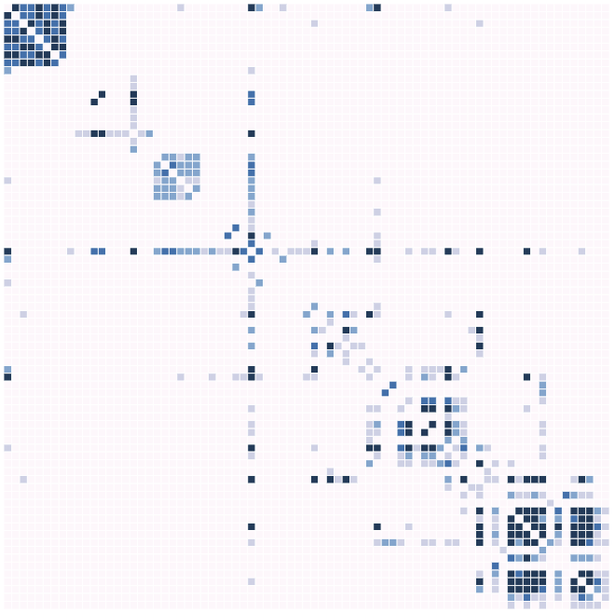
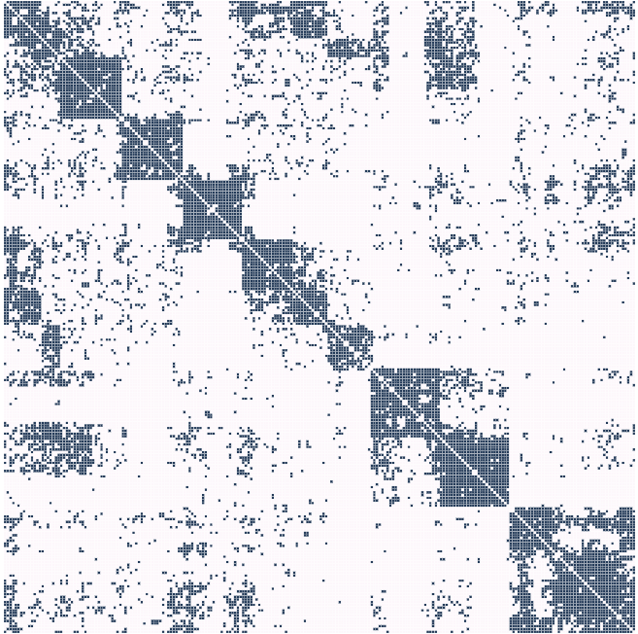
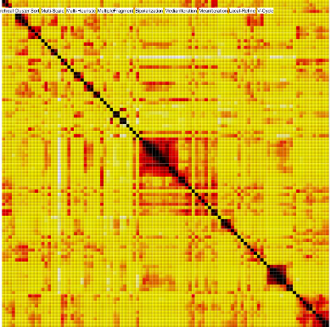
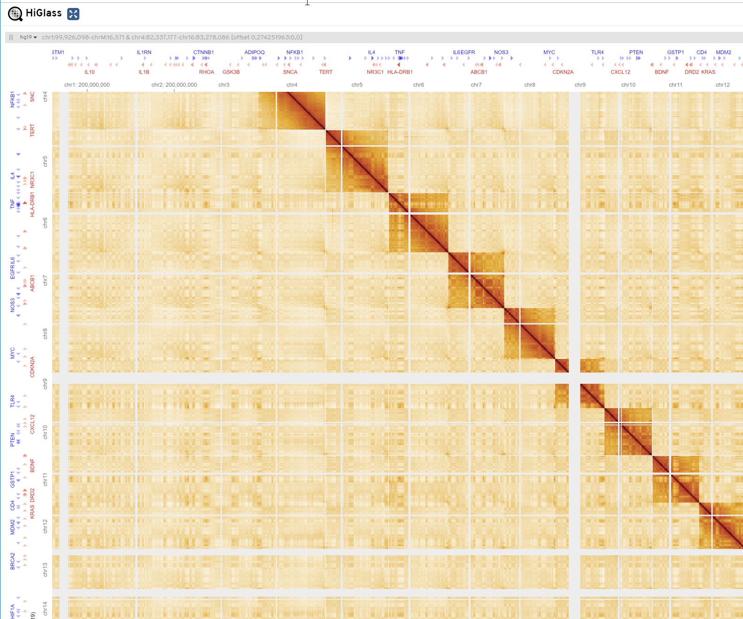
Compact representation
Small
Medium
Large
Beyond screen size
HiGlass.io
Notes:
Compact representation; technical scalability limit not until all display pixels are occupied
Overview tasks such as estimating the amount of nodes or edges, or lower level
tasks such as finding the most connected node,
Higher level tasks about the specific topology of the network,
require an appropriate reordering of rows and columns. T

Slide 3
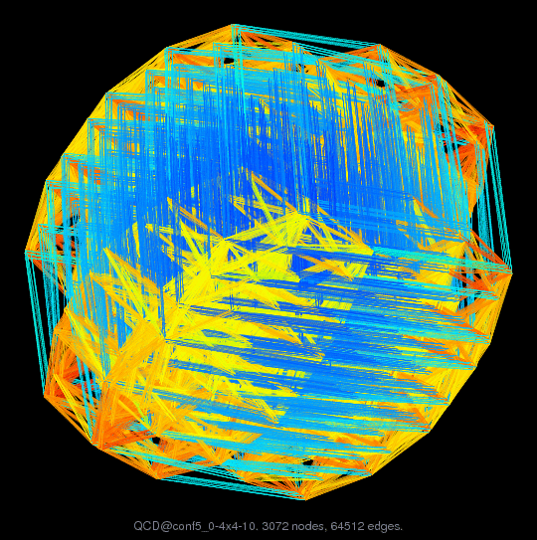
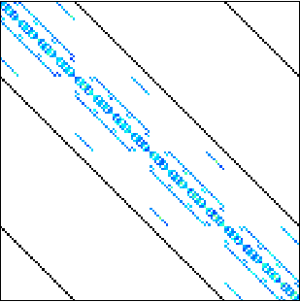
No Overplotting Issues
Quantum chemistry problem: Quantum chromodynamics conf 5.0-00l 4x4-1000: 3072 Nodes; 119,808 Edges
Images courtesy: The SuiteSparse Matrix Collection (formerly known as the University of Florida Sparse Matrix Collection) https://www.cise.ufl.edu/research/sparse/matrices/QCD/conf5_0-4x4-10.html
Notes:
Compact representation; technical scalability limit not until all display pixels are occupied
Overview tasks such as estimating the amount of nodes or edges, or lower level
tasks such as finding the most connected node,
Higher level tasks about the specific topology of the network,
require an appropriate reordering of rows and columns. T

Slide 4

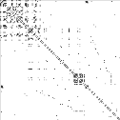
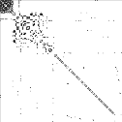
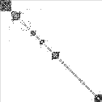
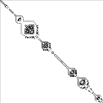
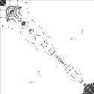
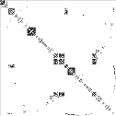
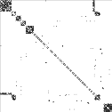

Simultaneous Overview and Detail
Overview independent of matrix reordering.
Higher level tasks require an reordering.
Other tasks only if patterns are visible.
Notes:
Compact representation; technical scalability limit not until all display pixels are occupied
Overview tasks such as estimating the amount of nodes or edges, or lower level
tasks such as finding the most connected node,
Higher level tasks about the specific topology of the network,
require an appropriate reordering of rows and columns. T

Slide 5
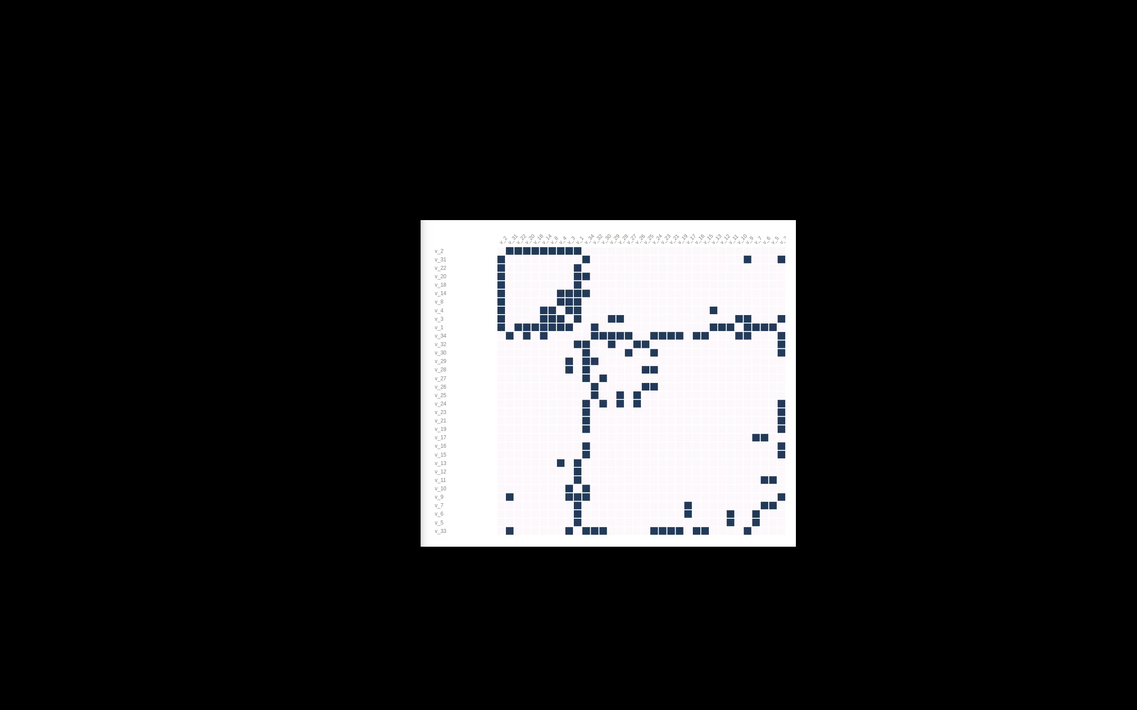
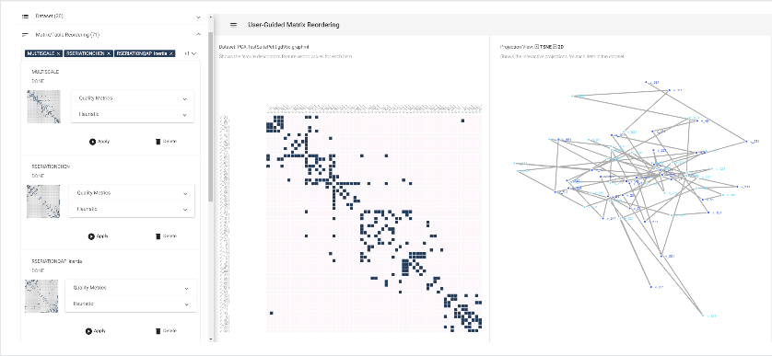
Rows/Columns can be freely Reordered
GUIRO Implementation
Notes:
Compact representation; technical scalability limit not until all display pixels are occupied
Overview tasks such as estimating the amount of nodes or edges, or lower level
tasks such as finding the most connected node,
Higher level tasks about the specific topology of the network,
require an appropriate reordering of rows and columns. T

Slide 6
Problem Statements

Slide 7
General User / Teacher
?
Which matrix reordering algorithm to choose?

Notes:
Compact representation; technical scalability limit not until all display pixels are occupied
Overview tasks such as estimating the amount of nodes or edges, or lower level
tasks such as finding the most connected node,
Higher level tasks about the specific topology of the network,
require an appropriate reordering of rows and columns. T

Slide 8
Network Analyst
?
Which local patterns are hidden in my data?

Notes:
Compact representation; technical scalability limit not until all display pixels are occupied
Overview tasks such as estimating the amount of nodes or edges, or lower level
tasks such as finding the most connected node,
Higher level tasks about the specific topology of the network,
require an appropriate reordering of rows and columns. T

Slide 9
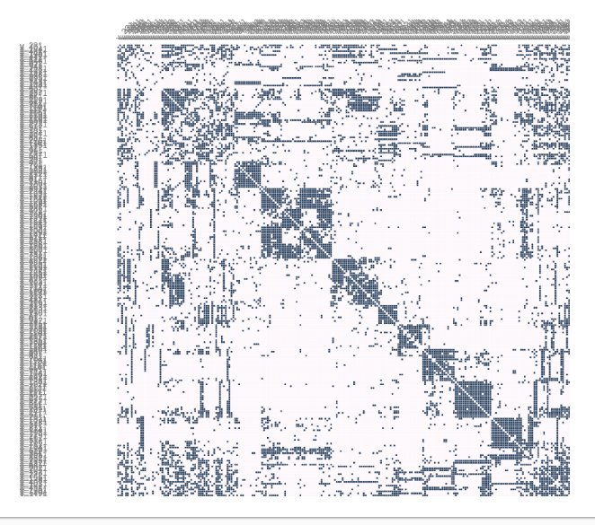
Network Analyst
?
Global patterns

Local patterns
Notes:
Compact representation; technical scalability limit not until all display pixels are occupied
Overview tasks such as estimating the amount of nodes or edges, or lower level
tasks such as finding the most connected node,
Higher level tasks about the specific topology of the network,
require an appropriate reordering of rows and columns. T

Slide 10
Algorithm Designer
?
How to design better reordering algorithms?
✴
Notes:
Compact representation; technical scalability limit not until all display pixels are occupied
Overview tasks such as estimating the amount of nodes or edges, or lower level
tasks such as finding the most connected node,
Higher level tasks about the specific topology of the network,
require an appropriate reordering of rows and columns. T

Slide 11
Related Work

Slide 12
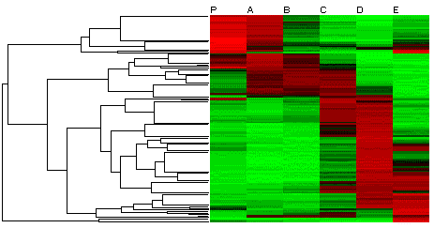
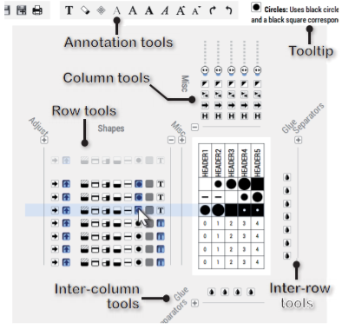
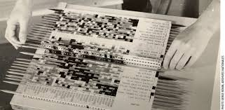
Related Work
[Caraux05]
[Perin14]
Manual
Matrix Reordering Approaches
Notes:
Compact representation; technical scalability limit not until all display pixels are occupied
Overview tasks such as estimating the amount of nodes or edges, or lower level
tasks such as finding the most connected node,
Higher level tasks about the specific topology of the network,
require an appropriate reordering of rows and columns. T

Slide 13
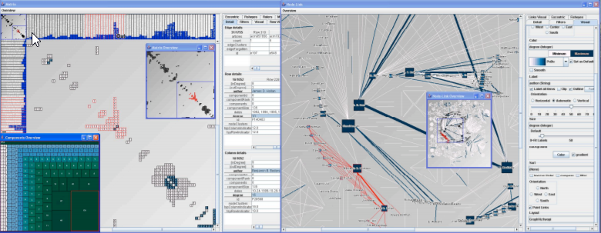
Related Work
[Caraux05]
[Henry06]
[Perin14]
Manual
Semi-Automatic
Matrix Reordering Approaches
Notes:
Compact representation; technical scalability limit not until all display pixels are occupied
Overview tasks such as estimating the amount of nodes or edges, or lower level
tasks such as finding the most connected node,
Higher level tasks about the specific topology of the network,
require an appropriate reordering of rows and columns. T

Slide 14

Related Work
[Caraux05]
[Liiv2010]
Robinsonian
Spectral Methods
Dimension Reduction
[Henry06]
Heuristic Approaches
Matrix Reordering
Graph-Theoretic
Biclustering
Approaches
Interactive Approaches
[Perin14]
[Behrisch2016]
Manual
Semi-Automatic
Automatic
Matrix Reordering Approaches
Notes:
Compact representation; technical scalability limit not until all display pixels are occupied
Overview tasks such as estimating the amount of nodes or edges, or lower level
tasks such as finding the most connected node,
Higher level tasks about the specific topology of the network,
require an appropriate reordering of rows and columns. T

Slide 15
Related Work
Model Steering/Repr. Opening the black-box
Guiro
71 algorithms transparently available
Manual
Semi-Automatic
Automatic
Matrix Reordering Approaches
Notes:
Compact representation; technical scalability limit not until all display pixels are occupied
Overview tasks such as estimating the amount of nodes or edges, or lower level
tasks such as finding the most connected node,
Higher level tasks about the specific topology of the network,
require an appropriate reordering of rows and columns. T

Slide 16
Approach

Slide 17
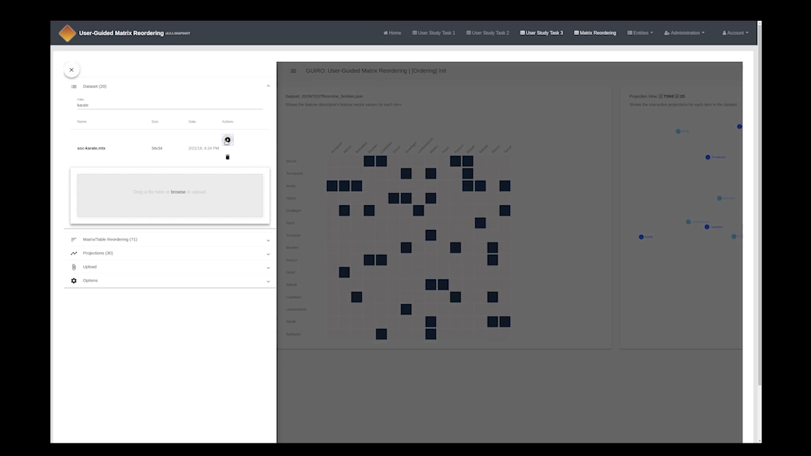



Guiro
Which matrix reordering algorithm to choose?
✴

71 Reordering Algorithms & Interactive Exploration
Notes:
Compact representation; technical scalability limit not until all display pixels are occupied
Overview tasks such as estimating the amount of nodes or edges, or lower level
tasks such as finding the most connected node,
Higher level tasks about the specific topology of the network,
require an appropriate reordering of rows and columns. T

Slide 18



Matrix Data
Reordered Matrix Data
Which local patterns are hidden in my data?
✴
Guided by Algorithm/Impl.
Quality Metric
Notes:
Compact representation; technical scalability limit not until all display pixels are occupied
Overview tasks such as estimating the amount of nodes or edges, or lower level
tasks such as finding the most connected node,
Higher level tasks about the specific topology of the network,
require an appropriate reordering of rows and columns. T

Slide 19


Matrix Data
Reordered Matrix Data
Which local patterns are hidden in my data?
Guided by Algorithm/Impl.
Quality Metric
?
Support Analysis Task
Notes:
Compact representation; technical scalability limit not until all display pixels are occupied
Overview tasks such as estimating the amount of nodes or edges, or lower level
tasks such as finding the most connected node,
Higher level tasks about the specific topology of the network,
require an appropriate reordering of rows and columns. T

Slide 20
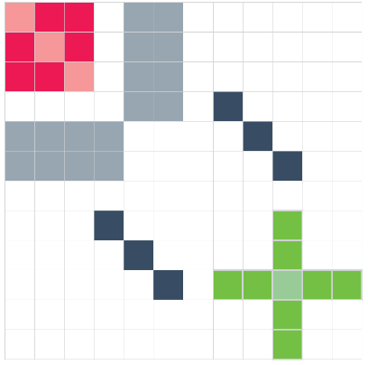
Opening and Steering of the Black-Box

Slide 21
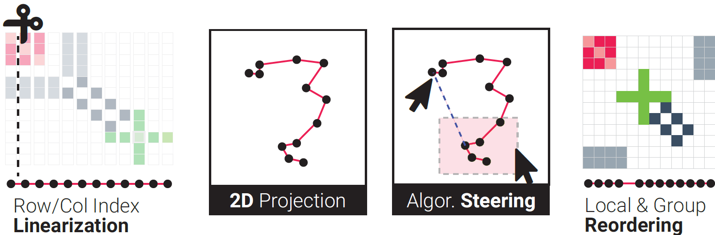
Opening and Steering of the Black-Box

Slide 22
Opening and Steering of the Black-Box
Model/Result Representation

Slide 23
Opening and Steering of the Black-Box

Slide 24
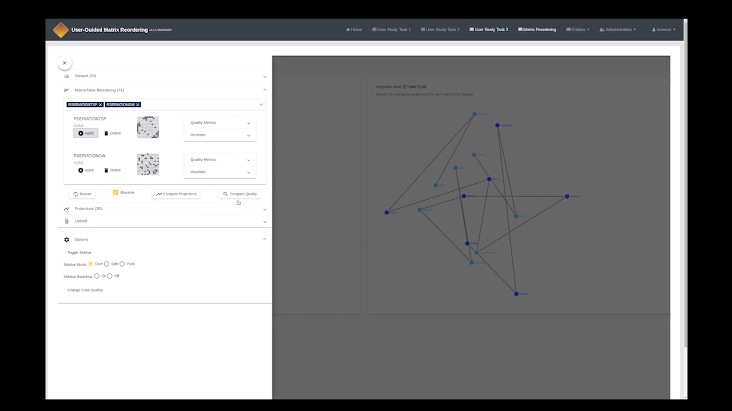


Which local patterns are hidden in my data?
✴

2D Proj. for Algorithm Steering & Understanding
Notes:
Compact representation; technical scalability limit not until all display pixels are occupied
Overview tasks such as estimating the amount of nodes or edges, or lower level
tasks such as finding the most connected node,
Higher level tasks about the specific topology of the network,
require an appropriate reordering of rows and columns. T

Slide 25
But… How do I know what to optimize?

Slide 26
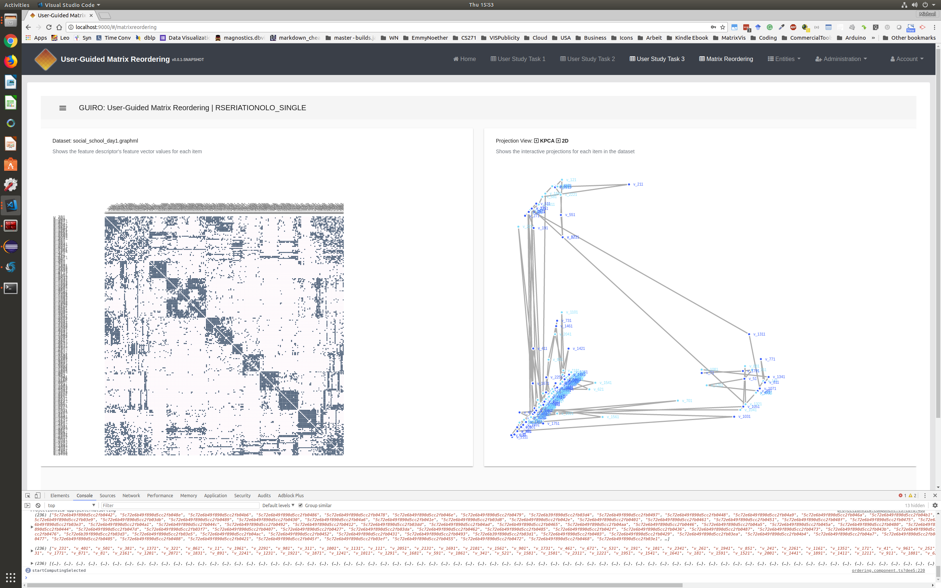
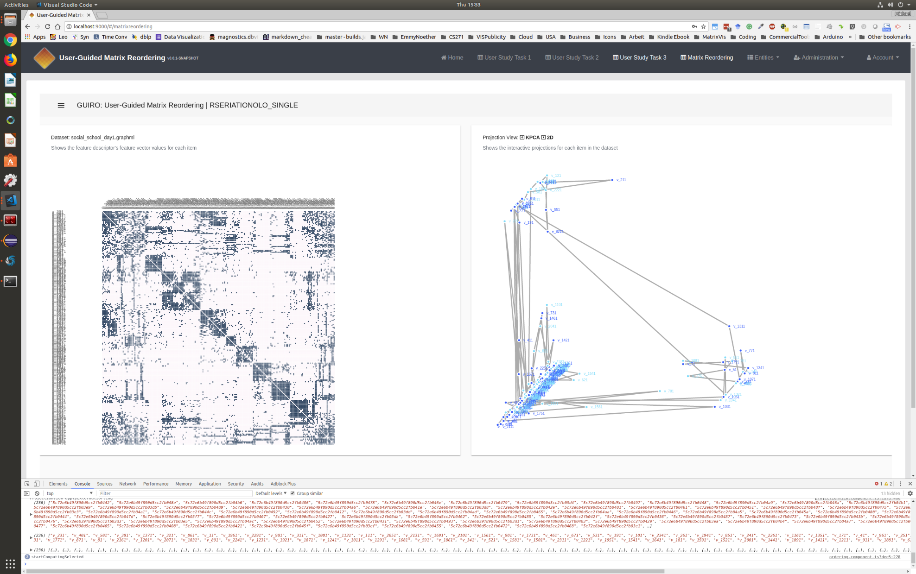
But… How do I know what to optimize?
Before

Slide 27
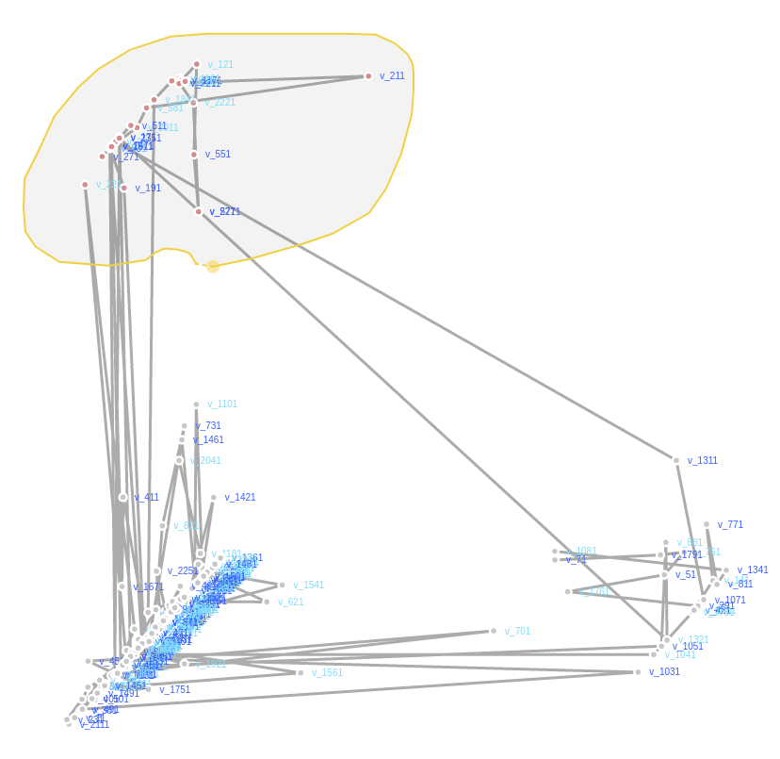
But… How do I know what to optimize?
Before

Slide 28
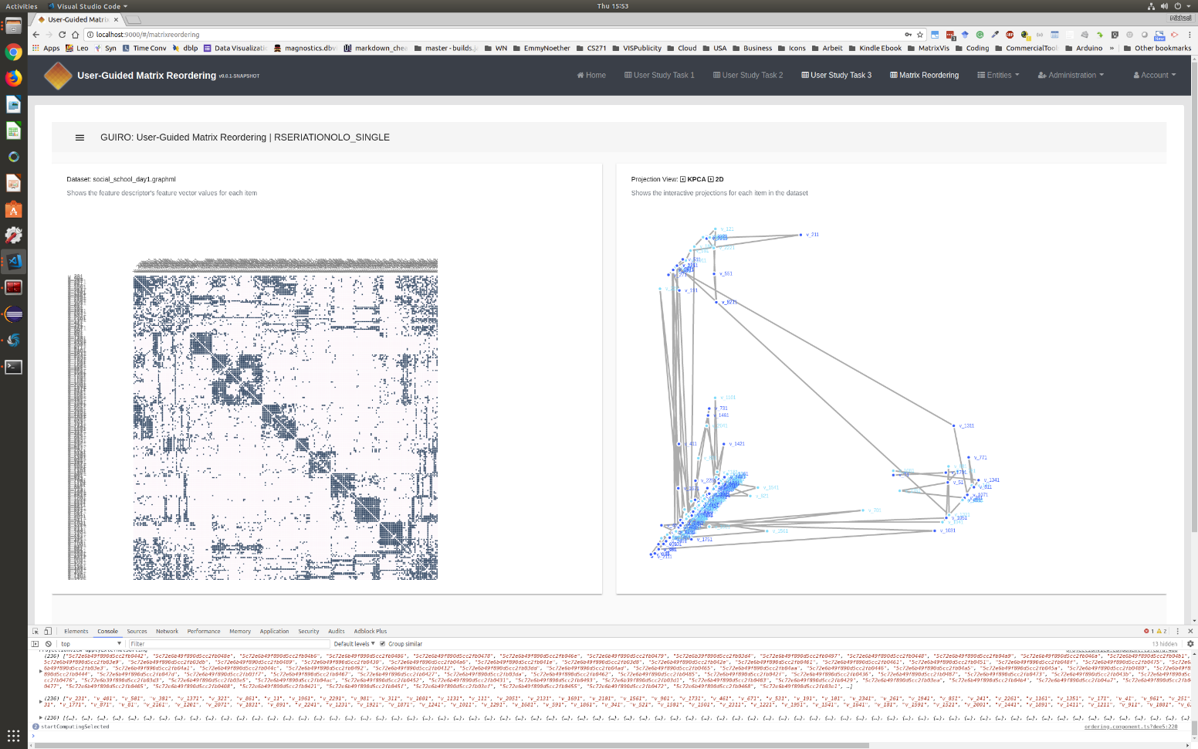
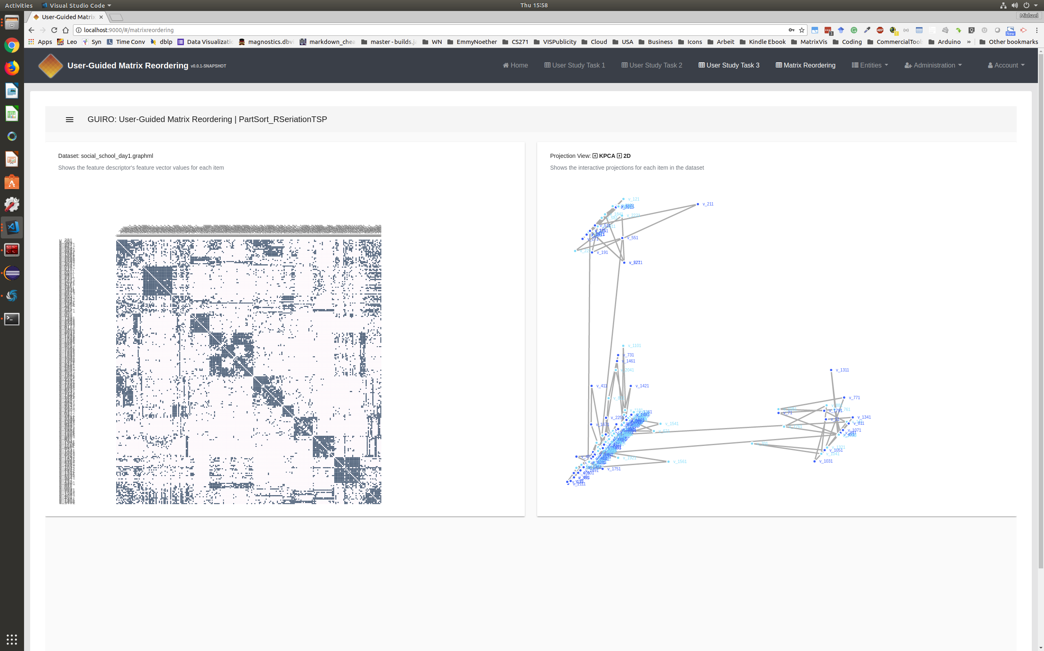
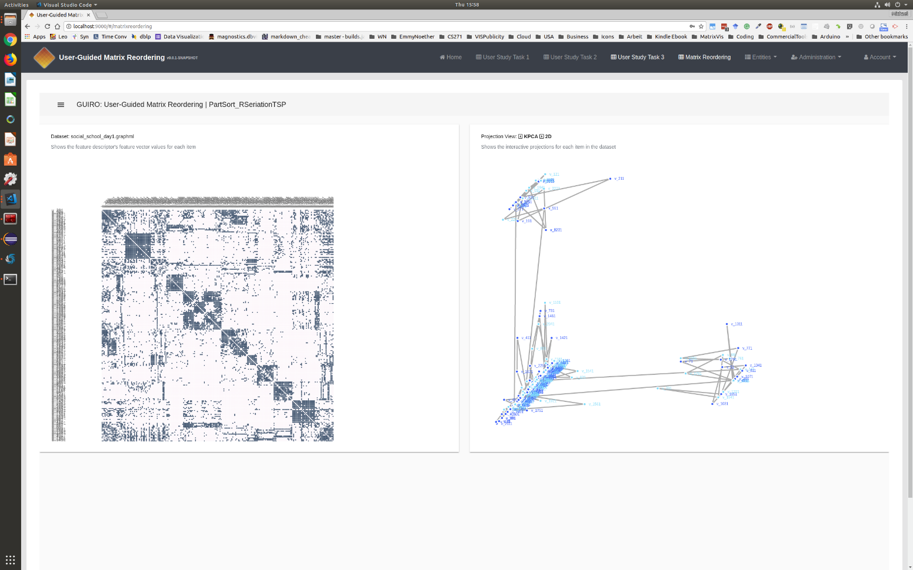
But… How do I know what to optimize?
Before
After

Slide 29
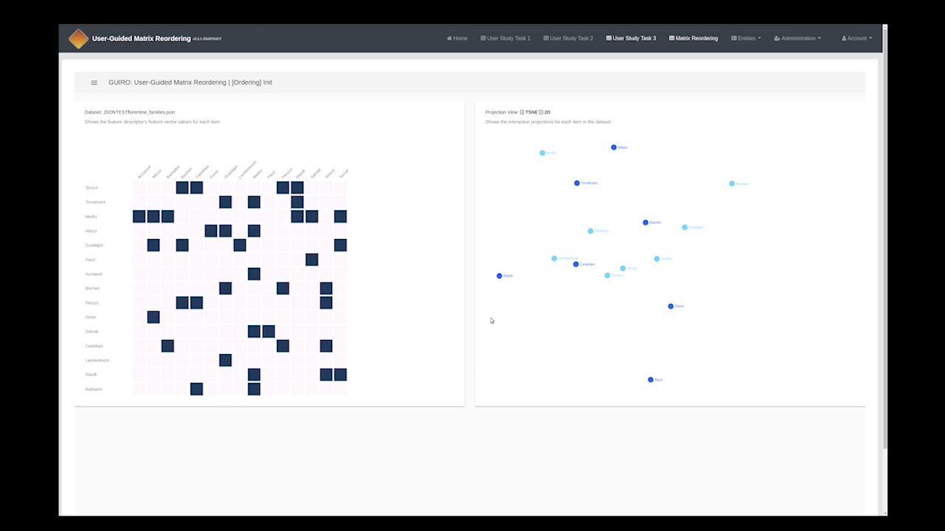

✴
How to design better reordering algorithms?
✴
Quality Metrics & Index-by-Index Comparison
Notes:
Compact representation; technical scalability limit not until all display pixels are occupied
Overview tasks such as estimating the amount of nodes or edges, or lower level
tasks such as finding the most connected node,
Higher level tasks about the specific topology of the network,
require an appropriate reordering of rows and columns. T

Slide 30
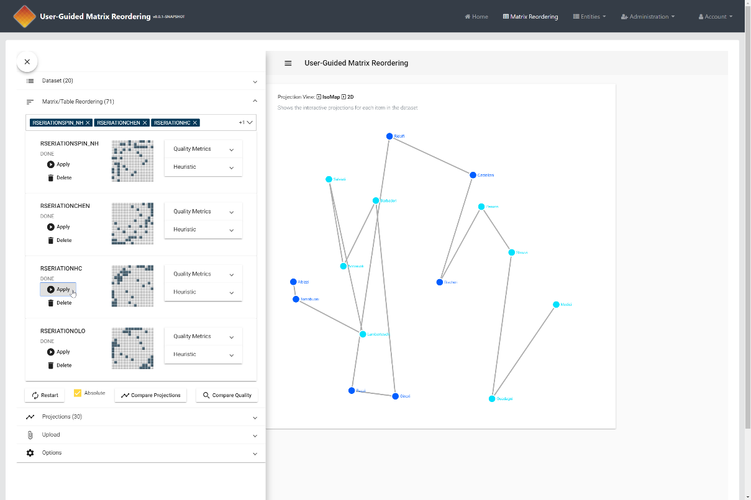
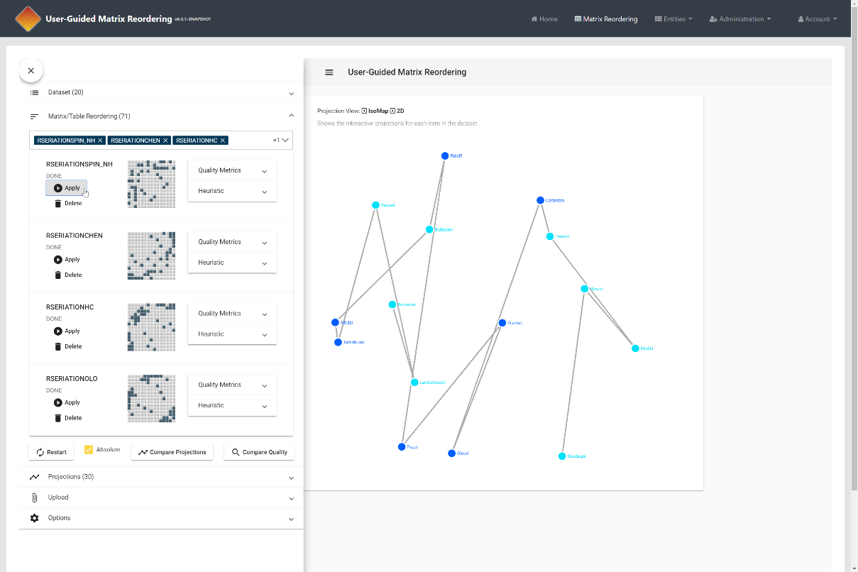
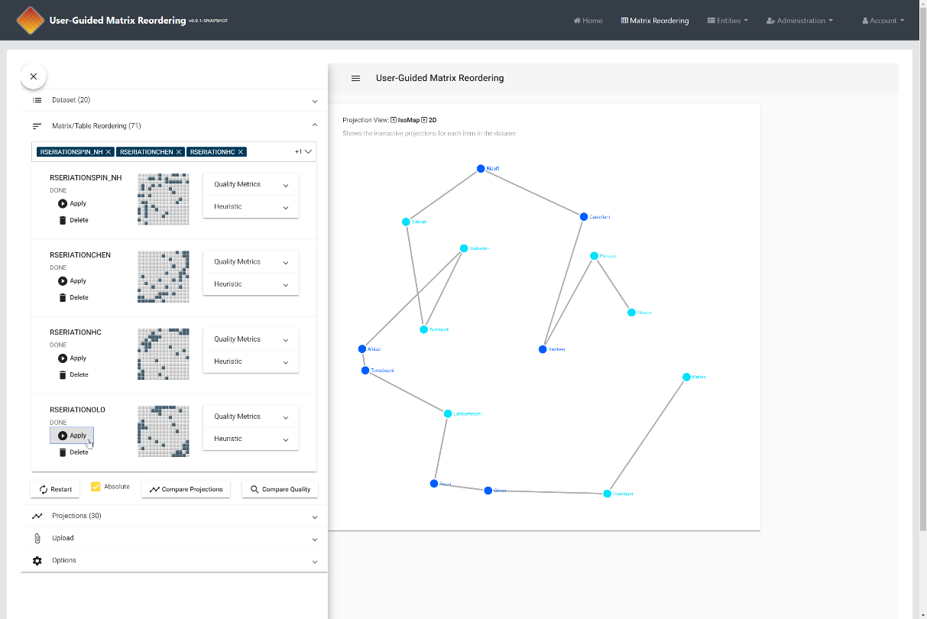
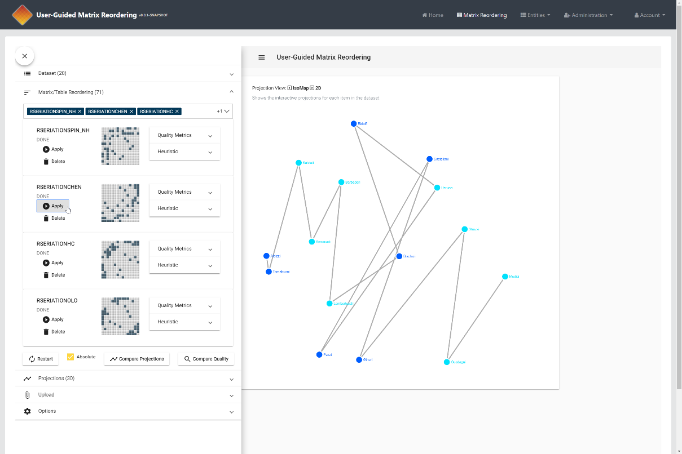
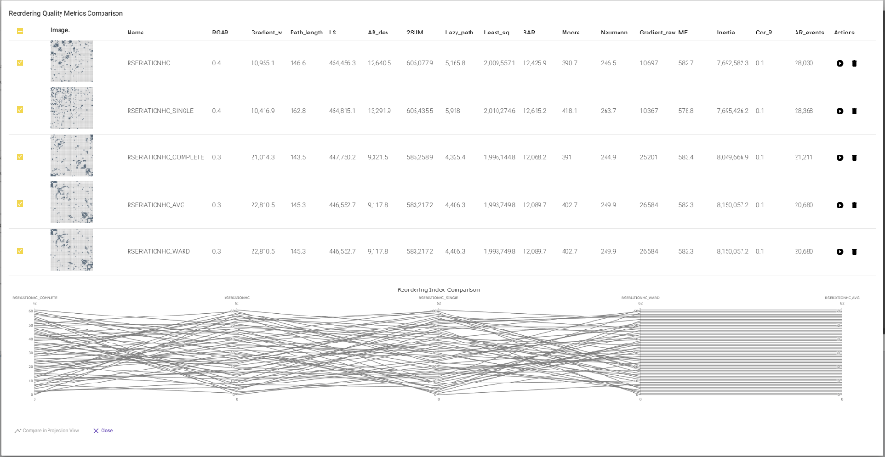

✴
How to design better reordering algorithms?
✴
Quality Metrics & Index-by-Index Comparison
Notes:
Compact representation; technical scalability limit not until all display pixels are occupied
Overview tasks such as estimating the amount of nodes or edges, or lower level
tasks such as finding the most connected node,
Higher level tasks about the specific topology of the network,
require an appropriate reordering of rows and columns. T

Slide 31
Evaluation/Results

Slide 32
Evaluation

User Study
12 participants evaluated usefulness
Case Study
Practical example of local pattern analysis
Expert Study
Leading researcher to gather feedback on the design decisions, computional- and work flow aspects
Notes:
Compact representation; technical scalability limit not until all display pixels are occupied
Overview tasks such as estimating the amount of nodes or edges, or lower level
tasks such as finding the most connected node,
Higher level tasks about the specific topology of the network,
require an appropriate reordering of rows and columns. T

Slide 33
Evaluation
“
The response was very positive, especially
about the aesthetics, the comprehensiveness of the algorithm
collection, and the meaningful usage of animations.
Expert Study
Leading researcher to gather feedback on the design decisions, computional- and work flow aspects
Notes:
Compact representation; technical scalability limit not until all display pixels are occupied
Overview tasks such as estimating the amount of nodes or edges, or lower level
tasks such as finding the most connected node,
Higher level tasks about the specific topology of the network,
require an appropriate reordering of rows and columns. T

Slide 34
Summary

Slide 35
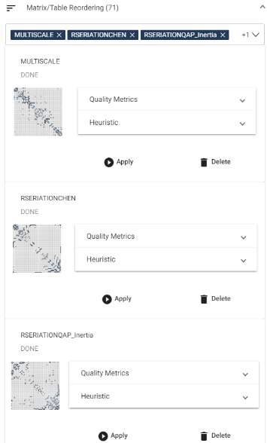
Guiro Contributions
!
Visual Interactive Overview
Compare result usefulness.
Demonstrate pattern variability.
Reveal the heuristic nature of algo.


✴
Notes:
Compact representation; technical scalability limit not until all display pixels are occupied
Overview tasks such as estimating the amount of nodes or edges, or lower level
tasks such as finding the most connected node,
Higher level tasks about the specific topology of the network,
require an appropriate reordering of rows and columns. T

Slide 36
Guiro Contributions
!

Technical Contributions
Two novel interactive algorithms for fine-grained algorithm steering

✴
Notes:
Compact representation; technical scalability limit not until all display pixels are occupied
Overview tasks such as estimating the amount of nodes or edges, or lower level
tasks such as finding the most connected node,
Higher level tasks about the specific topology of the network,
require an appropriate reordering of rows and columns. T

Slide 37
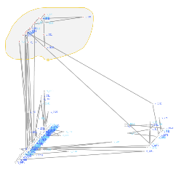
Guiro Contributions
!

Technical Contributions
Novel concept for a User-guided Composite Matrix Reordering

✴
Notes:
Compact representation; technical scalability limit not until all display pixels are occupied
Overview tasks such as estimating the amount of nodes or edges, or lower level
tasks such as finding the most connected node,
Higher level tasks about the specific topology of the network,
require an appropriate reordering of rows and columns. T

Slide 38
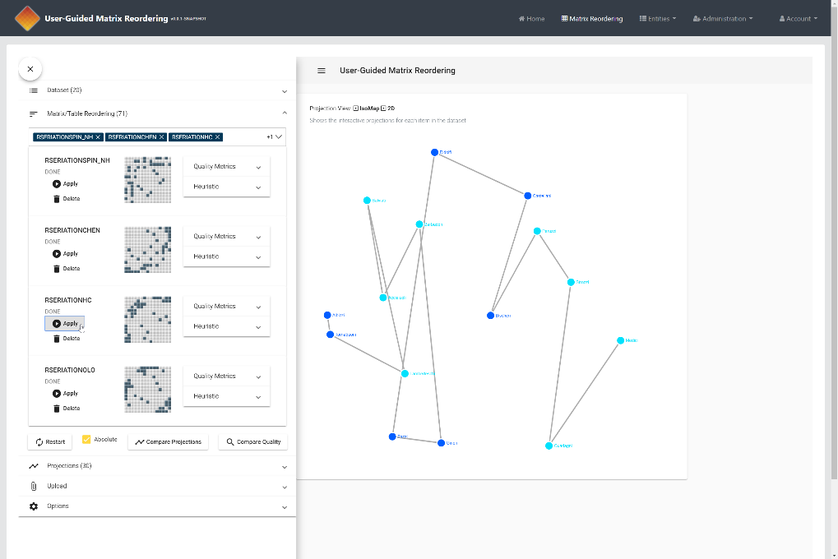
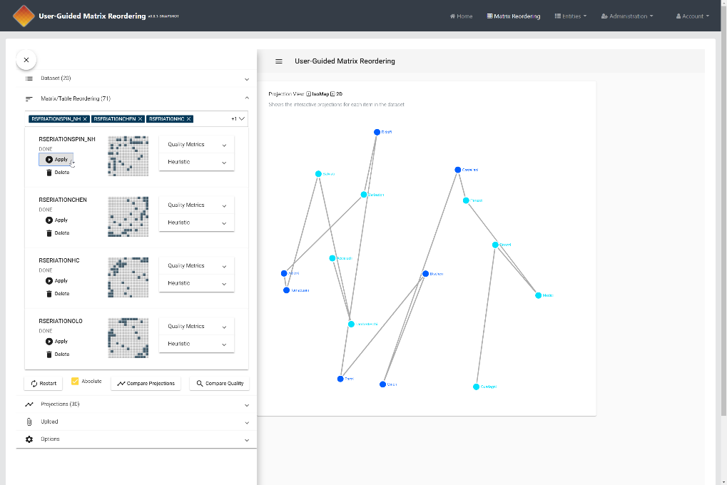
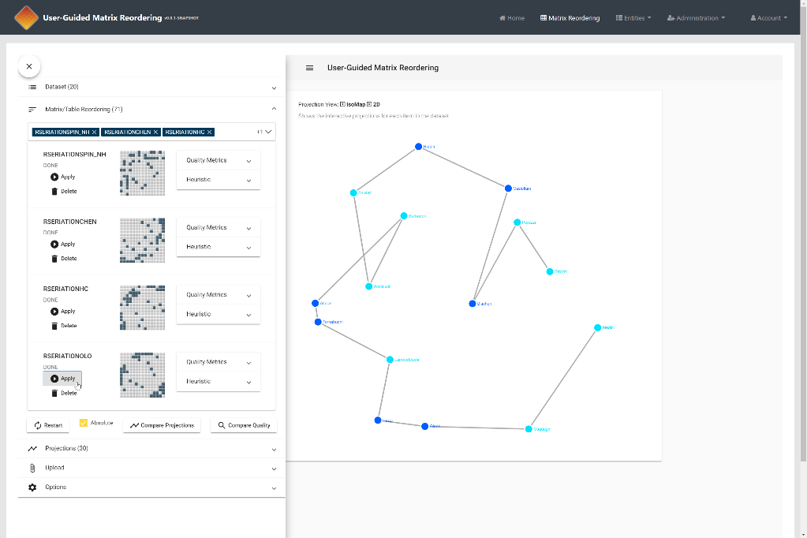

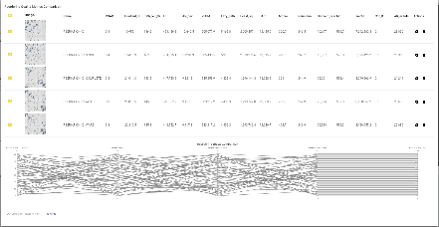
Guiro Contributions
!

Visual Overview and Comparison
Index-to-Index comparison Projection View and PcP view

✴
Notes:
Compact representation; technical scalability limit not until all display pixels are occupied
Overview tasks such as estimating the amount of nodes or edges, or lower level
tasks such as finding the most connected node,
Higher level tasks about the specific topology of the network,
require an appropriate reordering of rows and columns. T

Slide 39

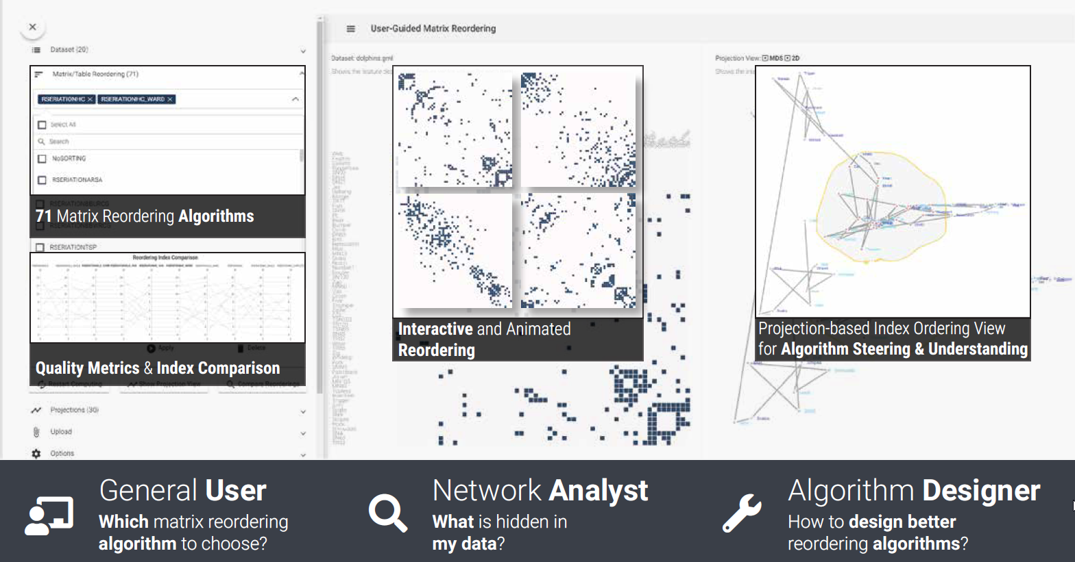
Guiro
User-Guided Matrix Reordering
?
Shameless
Self-Advertising
There are MANY open cool questions, also non-matrix related! Contact me for Master Thesis Projects!
Questions?
Dr. Michael Behrisch | @michaelbehrisch | m.behrisch@uu.nl | michael.behrisch.info

